Slide 1
Financial report 2017

Slide 2
NON-GOVERNMENTAL UNION "FOUNDATION FOR SUPPORT OF REFORMS IN UKRAINE"
Non-governmental union "Foundation for support of reforms in Ukraine" is an independent, non-governmental union that has been operating since 2015.
The Foundation was founded at the discretion of the National Reforms Council jointly with the European Bank for Reconstruction and Development, at support of International Renaissance Foundation. "Foundation for support of reforms in Ukraine" foundation was stipulated in a panel session of the National Reforms Council through the President of Ukraine and the other members of NRC.
Our objective and primary goal is to promote the development of Ukraine and improve the material well-being of its citizens by supporting the development and implementation of reforms in Ukraine.
The organization is financially backed by the international funders and separate Ukrainian and foreign organizations and citizens. All launched initiatives and implemented projects will be published in the Foundation annual reports and brief graphical reports in the course of the year.
The Governing bodies of the "Foundation for support of reforms in Ukraine" is the Meeting (the supreme governing body), Supervisory Board (supervisory body concerning statutory and financial activities and Fund assets permitted use) and the Executive Director.
The Executive Director of the Non-governmental union "Foundation for support of reforms in Ukraine" is Yuriy Shkil.
Financial report 2017
2

Slide 3
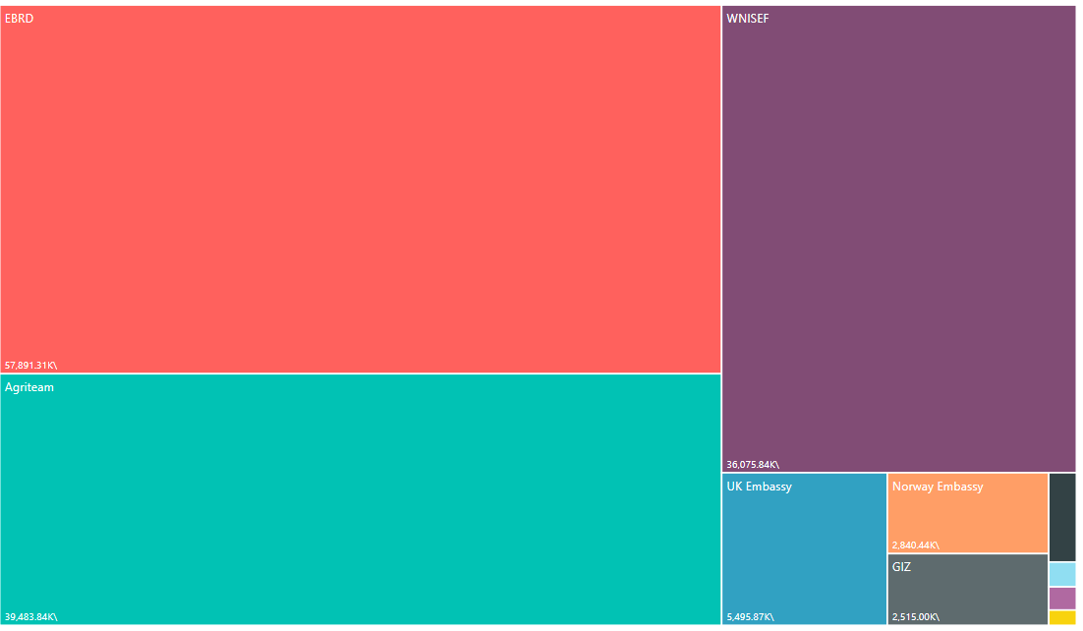
Funding contributions split by Donors
Donor | Funding, in thousand UAH | % of funding
EBRD | 57,891.31 | 39,86%
Agriteam Ca | 39,483.84 | 27,19%
WNISEF | 36,075.84 | 24,84%
UK Embassy | 5,495.87 | 3,78%
Norway Embassy | 2,840.44 | 1,96%
GIZ | 2,515.00 | 1,73%
Datagroup | 537.24 | 0,37%
International Renaissance foundation | 150.07 | 0,10%
Transparency International | 139.51 | 0,10%
Association4u | 92.01 | 0,06%
Financial report 2017
3

Slide 4
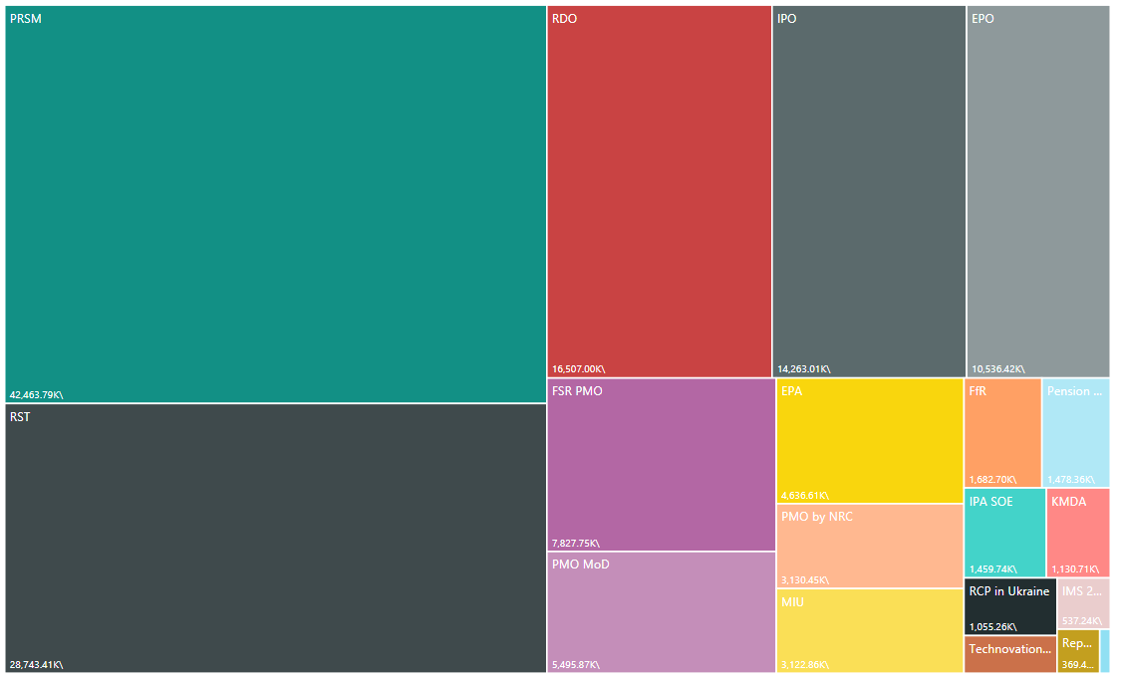
Funding contributions split by Projects
Project | Funding, in thousand UAH | % of funding
PRSM | 42,463.79 | 29,24%
RST | 28,743,41 | 19,79%
RDO | 16,507.00 | 11,37%
IPO | 14,263.01 | 9,82%
EPO | 10,536.42 | 7,26%
FSR PMO | 7,827.75 | 5,39%
PMO MoD | 5,495.87 | 3,78%
EPA | 4,363.61 | 3,19%
PMO by NRC | 3,130.45 | 2,16%
MIU | 3,122.86 | 2,15%
Pension reform awareness | 1,478.36 | 1,02%
IPA SOE | 1,459.74 | 1,01%
KMDA | 1,130.71 | 0,78%
RCP in Ukraine | 1,055.26 | 0,73%
Technovation challenge | 688.46 | 0,47%
IMS 2017 | 537.24 | 0,37%
NRC report printing | 369.49 | 0,25%
EU-UA Association Agreement | 92.01 | 0,06%
Financial report 2017
4

Slide 5
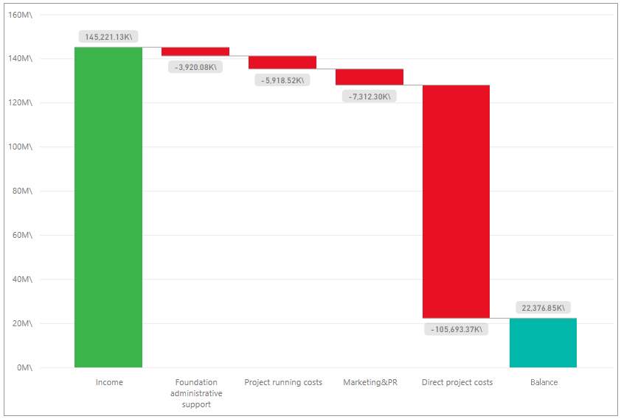
P&L 2017 Total
Category | Amount, in thousand UAH | %
Contributions | 145,221.13
Expenditures | 122,844.28 | :
Direct project costs | 105,693.37 | 86,04 %
Project marketing & PR | 7,312.30 | 5,95 %
Project running costs | 5,918.52 | 4,82 %
Foundation administrative support | 3,920.08 | 3,19 %
Balance | 22,376.85
Financial report 2017
5

Slide 6
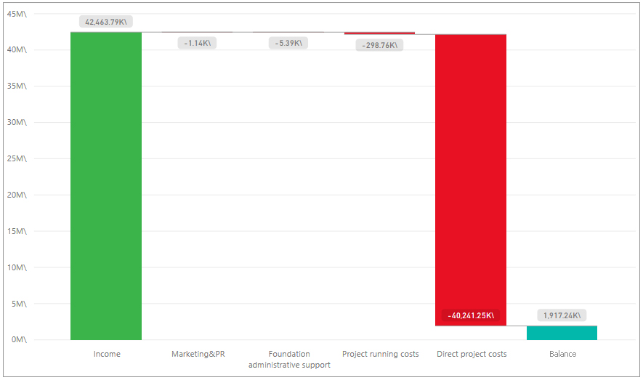
Professionals for reform support mechanism (PRSM)
Category | Amount, in thousand UAH | %
Contributions | 42,463.79
Expenditures | 40,546. | 55 :
Direct project costs | 40,241.25 | 99,247%
Project marketing & PR | 298.76 | 0,737%
Project running costs | 5.39 | 0,013%
Foundation administrative support | 1.14 | 0,003%
Balance | 1,917.24
Project managers: 111
Financial report 2017
6

Slide 7
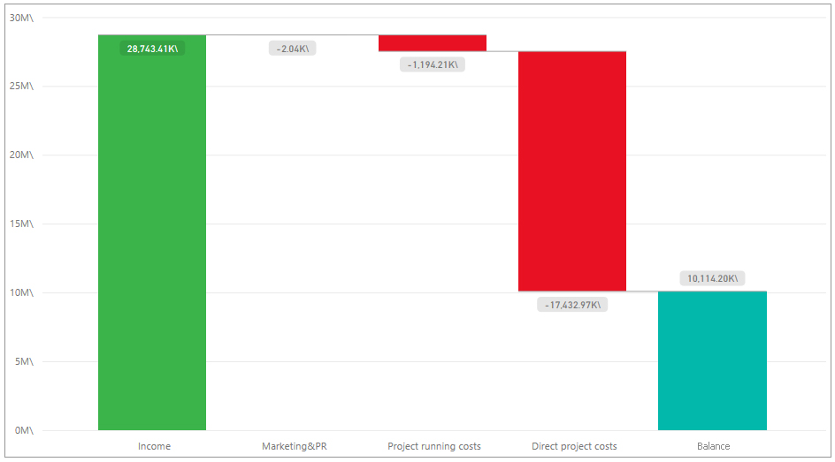
Support for institutions under the reform support architecture for Ukraine – Reform Support Teams(RST)
Category | Amount, in thousand UAH | %
Contributions | 28,743.41
Expenditures | 18,629.21 | :
Direct project costs | 17,432.97 | 93.58%
Project running costs | 1,194.21 | 6.41%
Project marketing & PR | 2.04 | 0.01%
Balance | 10,114.20
Project managers: 75
Financial report 2017
7

Slide 8
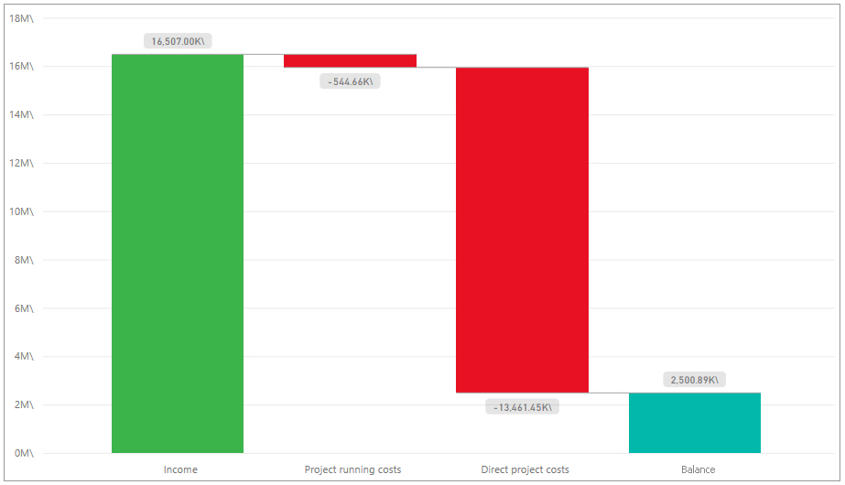
Support for institutions under the reform support architecture for Ukraine – Reforms Delivery Office(RDO)
Category | Amount, in thousand UAH | %
Contributions | 16,507.00
Expenditures | 14,006.11
Direct project costs | 13,461.45 | 96,11%
Project running costs | 544.66 | 3,89%
Balance | 2,500.89
Project managers: 20
Financial report 2017
8

Slide 9
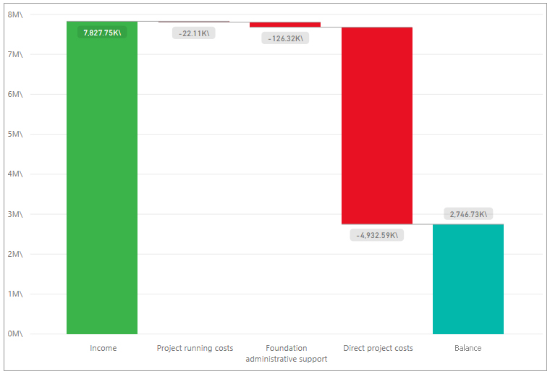
Project Management Offices for Financial Sector Reform in Ukraine (FSR PMO)
Category | Amount, in thousand UAH | %
Contributions | 7,827.75
Expenditures | 5,081.02
Direct project costs | 4,932.59 | 97,08%
Foundation administrative support | 126.32 | 2,49%
Project running costs | 22.11 | 0,44%
Balance | 2,746.73
Project managers: 15
Financial report 2017
9

Slide 10
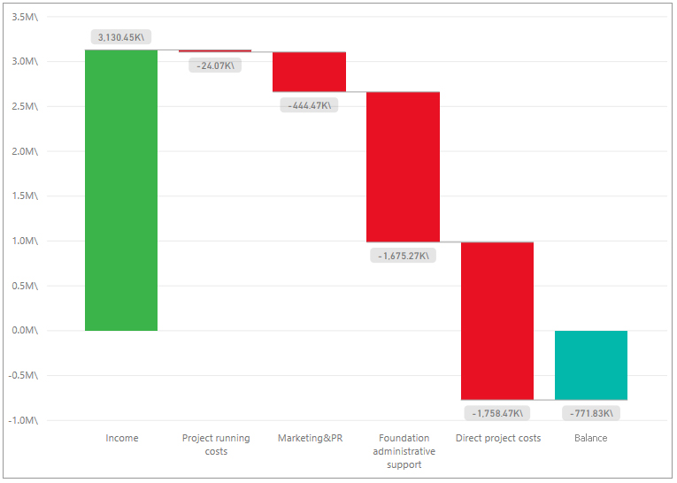
Support for institutions under the reform support architecture for Ukraine – Support Team of the National Reform Council (NRC ST)
Category | Amount, in thousand UAH | %
Contributions | 3,130.45
Expenditures | 3,902.28
Direct project costs | 1,758.47 | 45,06%
Foundation administrative support | 1,675.27 | 42,93%
Project marketing & PR | 444.47 | 11,39%
Project running cost | 24.07 | 0,62%
Balance | -771.83
Project managers: 3
Financial report 2017
10

Slide 11
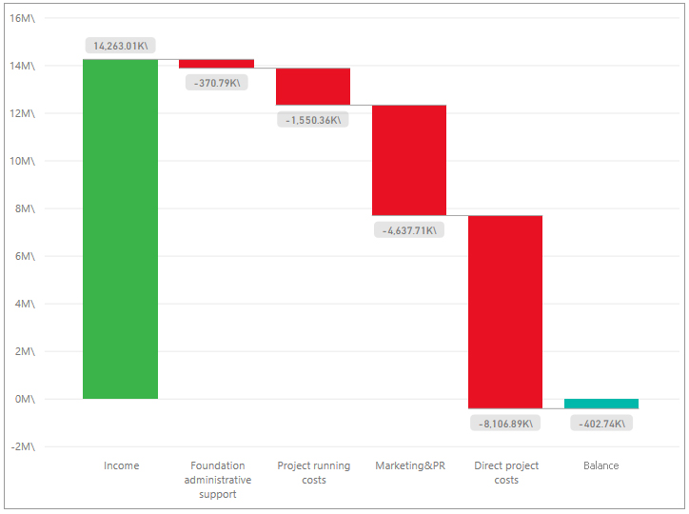
Investment promotion office (IPO)
Category | Amount, in thousand UAH | %
Contributions | 14,263.01
Expenditures | 14,665.75 | :
Direct project costs | 8,106.89 | 55,28%
Project marketing & PR | 4,637.71 | 31,62%
Project running cost | 1,550.36 | 10,57%
Foundation administrative support | 370.79 | 2,53%
Balance | -402.74
Project managers: 20
Financial report 2017
11

Slide 12
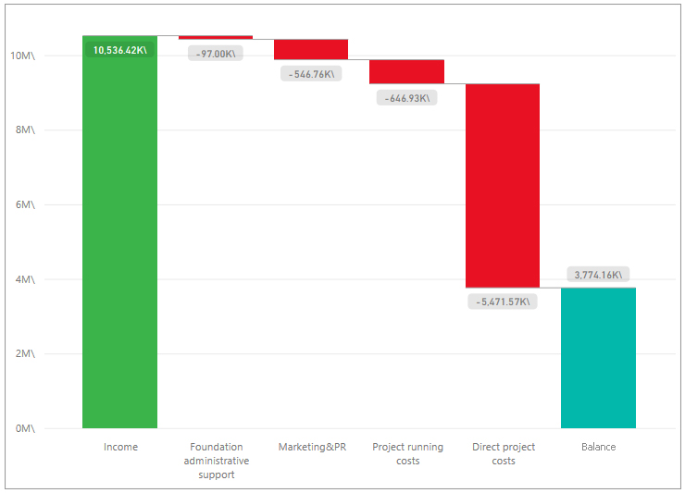
Export promotion office (EPO)
Category | Amount, in thousand UAH | %
Contributions | 10,536.42
Expenditures | 6,762.26
Direct project costs | 5,471.57 | 80,91%
Project running costs | 646.93 | 9,57%
Project marketing & PR | 546.76 | 8,09%
Foundation administrative support | 97.00 | 1,43%
Balance | 3,774.16
Project managers: 16
Financial report 2017
12

Slide 13
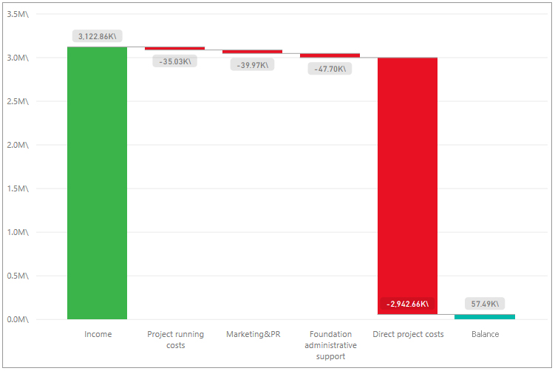
Support to infrastructure sector reforms (MIU)
Category | Amount, in thousand UAH | %
Contributions | 3,122.86
Expenditures | 3,065.37
Direct project costs | 2,942.66 | 96,00%
Foundation administrative support | 47.70 | 1,56%
Project marketing & PR | 39.97 | 1,30%
Project running cost | 35.03 | 1,14%
Balance | 57.49
Project managers: 11
Financial report 2017
13

Slide 14
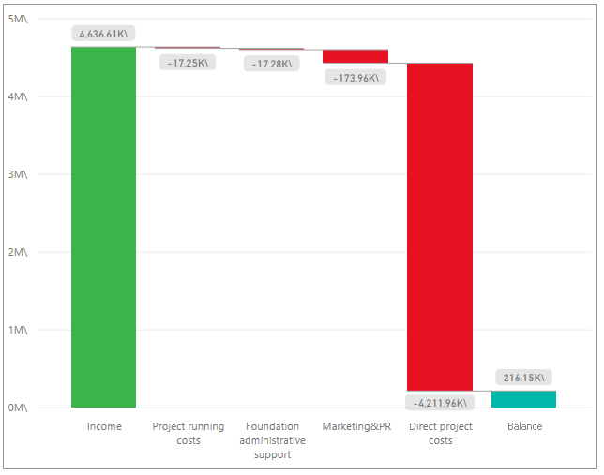
National Export Promotion Policy Development and Implementation Assistance (EPA)
Category | Amount, in thousand UAH | %
Contributions | 4,636.61
Expenditures | 4,420.46
Direct project costs | 4,211.96 | 95,28%
Project marketing & PR | 173.96 | 3,94%
Foundation administrative support | 17.28 | 0,39%
Project running cost | 17.25 | 0,39%
Balance | 216.15
Project managers: 9
Financial report 2017
14

Slide 15
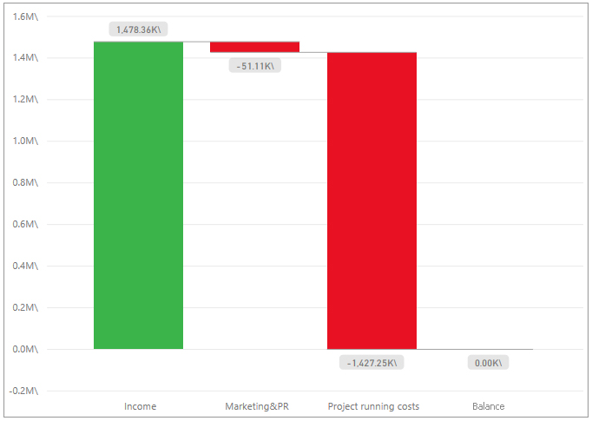
Increasing awareness about pension reform in Ukraine (Pension reform awareness)
Category | Amount, in thousand UAH | %
Contributions | 1,478.36
Expenditures | 1,478.36
Project running cost | 1,427.25 | 96,54%
Project marketing & PR | 51.11 | 3,46%
Balance | 0.00
Financial report 2017
15

Slide 16
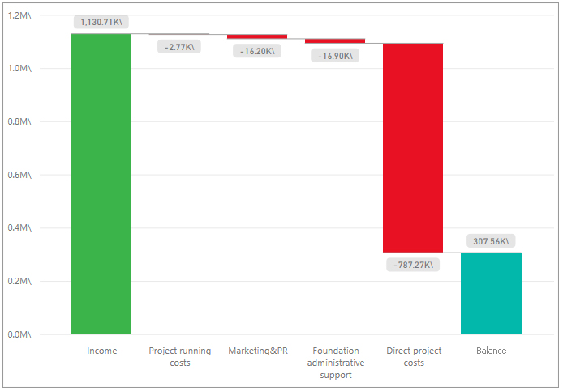
Correction, Update and Verification of Kyiv Advertising Fixture Location Data (KMDA)
Category | Amount, in thousand UAH | %
Contributions | 1,130.71
Expenditures | 823.15
Direct project costs | 787.27 | 95,64%
Foundation administrative support | 16.90 | 2,05%
Project marketing & PR | 16.20 | 1,97%
Project running cost | 2.77 | 0,34%
Balance | 307.56
Financial report 2017
16

Slide 17
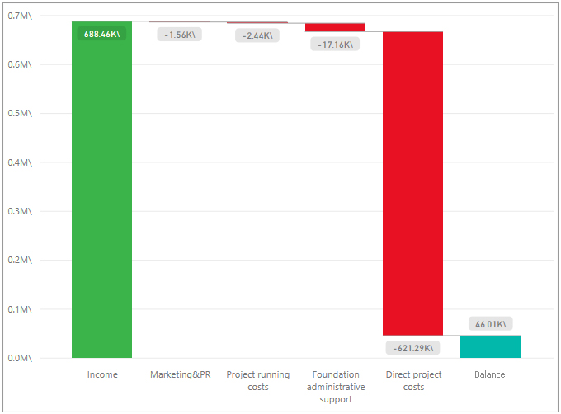
Technovation Challenge Ukraine (Technovation challenge)
Category | Amount, in thousand UAH | %
Contributions | 688.46
Expenditures | 642.45
Direct project costs | 621.29 | 96,71%
Foundation administrative support | 17.16 | 2,67%
Project running cost | 2.44 | 0,38%
Project marketing & PR | 1.56 | 0,24%
Balance | 46.01
Financial report 2017
17

Slide 18
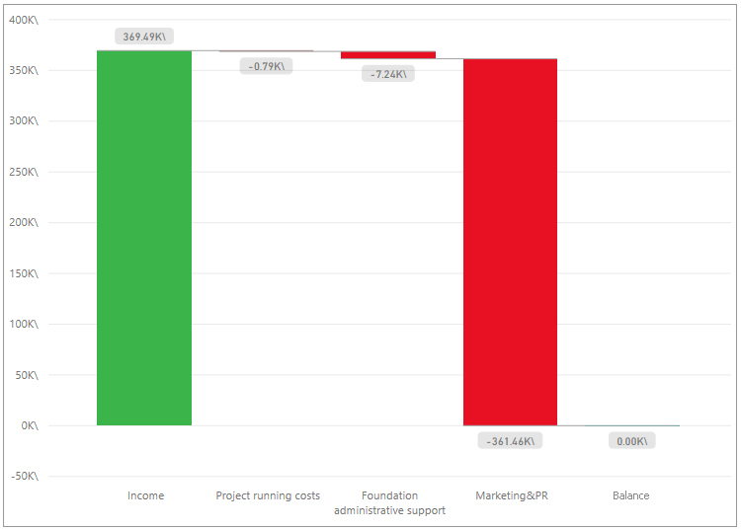
Printing the National Reforms Council Report “Reform progress monitoring 2016” (NRC report printing)
Category | Amount, in thousand UAH | %
Contributions | 369.49
Expenditures | 369.49
Project marketing & PR | 361.46 | 97,83%
Foundation administrative support | 7.24 | 1,96%
Project running cost | 0.79 | 0,21%
Balance | 0.00
Financial report 2017
18

Slide 19
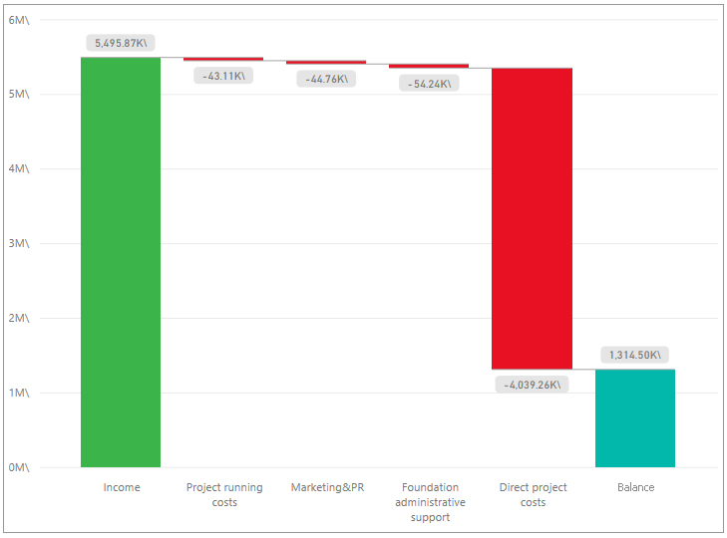
Project managers office for Ministry of Defense (PMO MoD)
Category | Amount, in thousand UAH | %
Contributions | 5,495.87
Expenditures | 4,181.37
Direct project costs | 40,39.26 | 96,60%
Foundation administrative support | 54.24 | 1,30%
Project marketing & PR | 44.76 | 1,07%
Project running cost | 43.11 | 1,03%
Balance | 1,314.5
Project managers: 20
Financial report 2017
19

Slide 20
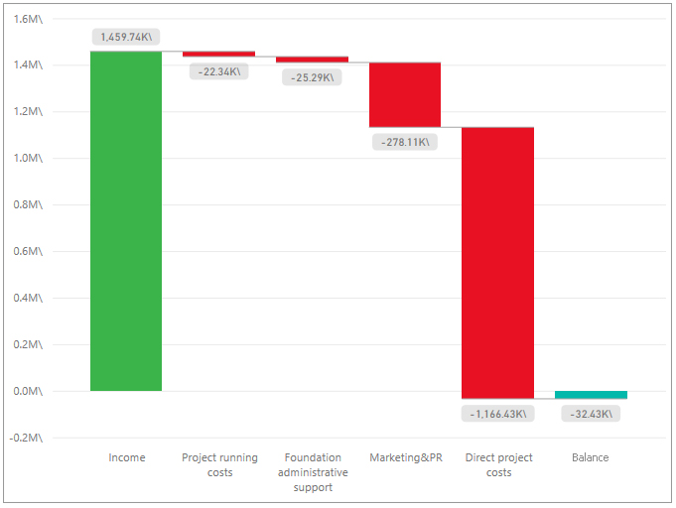
Investment promotion administration & State owned enterprises (IPA SOE)
Category | Amount, in thousand UAH | %
Contributions | 1,459.74
Expenditures | 1,492.17
Direct project costs | 1,166.43 | 78,17%
Project marketing & PR | 278.11 | 18,64%
Foundation administrative support | 25.29 | 1,69%
Project running cost | 22.34 | 1,50%
Balance | -32.43
Project managers: 8
Financial report 2017
20

Slide 21
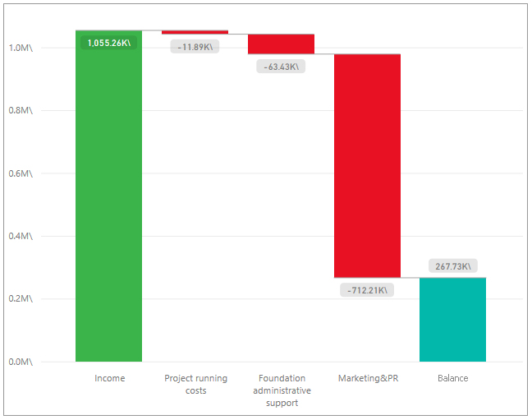
Reforms communication project in Ukraine (RCP in Ukraine)
Category | Amount, in thousand UAH | %
Contributions | 1,055.26
Expenditures | 787.53
Project marketing & PR | 712.21 | 90,44%
Foundation administrative support | 63.43 | 8,05%
Project running cost | 11.89 | 1,51%
Balance | 267.73
Project managers: 4
Financial report 2017
21

Slide 22
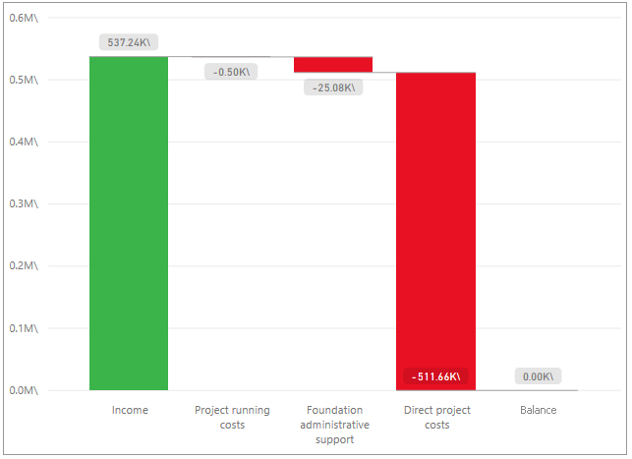
International Mayors’ Summit 2017 (IMS 2017)
Category | Amount, in thousand UAH | %
Contributions | 537.24
Expenditures | 537.24
Direct project costs | 511.66 | 95,24%
Foundation administrative support | 25.08 | 4,67%
Project running cost | 0.50 | 0,09%
Balance | 0.00
Financial report 2017
22

Slide 23
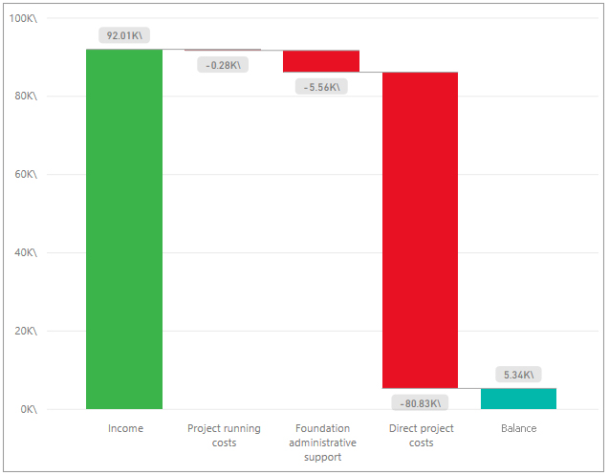
Support to the Implementation of the European Union – Ukraine Association Agreement” Project (EU-UA Association Agreement)
Category | Amount, in thousand UAH | %
Contributions | 92.01
Expenditures | 86.67
Direct project costs | 80.83 | 93,26%
Foundation administrative support | 5.56 | 6,42%
Project running cost | 0.28 | 0,32%
Balance | 5.34
Financial report 2017
23

Slide 24
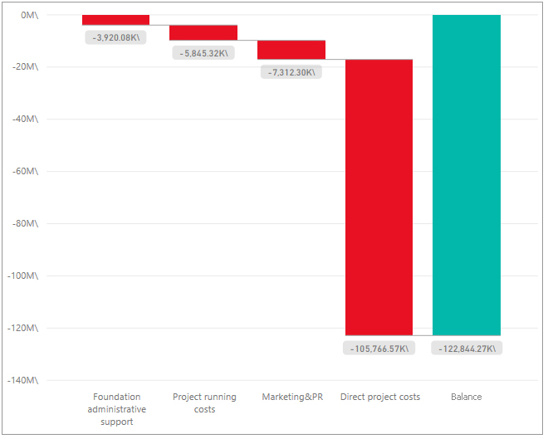
Expenditures breakdown by category
Category | Expenses, in thousand UAH | % of funding
Direct project costs | 105,766.57 | 86,10%
Project marketing & PR | 7,312.30 | 5,95%
Project running costs | 5,845.32 | 4,76%
Foundation administrative support | 3,920.08 | 3,19%
Total | 122,844.27 | 100,00%
Financial report 2017
24

Slide 25
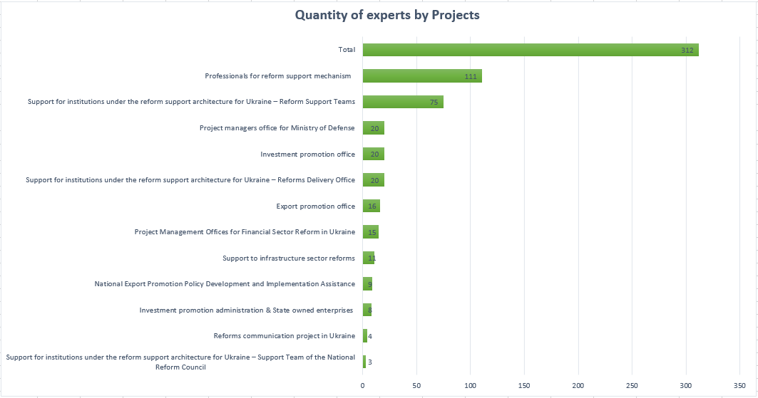
Financial report 2017
25

